Slide 1
Microsoft Build

Slide 2
Knowledge Retrieval:
RAG for enterprise agents with Azure AI Search
Pablo Castro
CVP & Distinguished Engineer, Azure AI Search

Slide 3
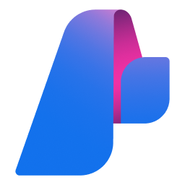
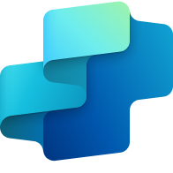
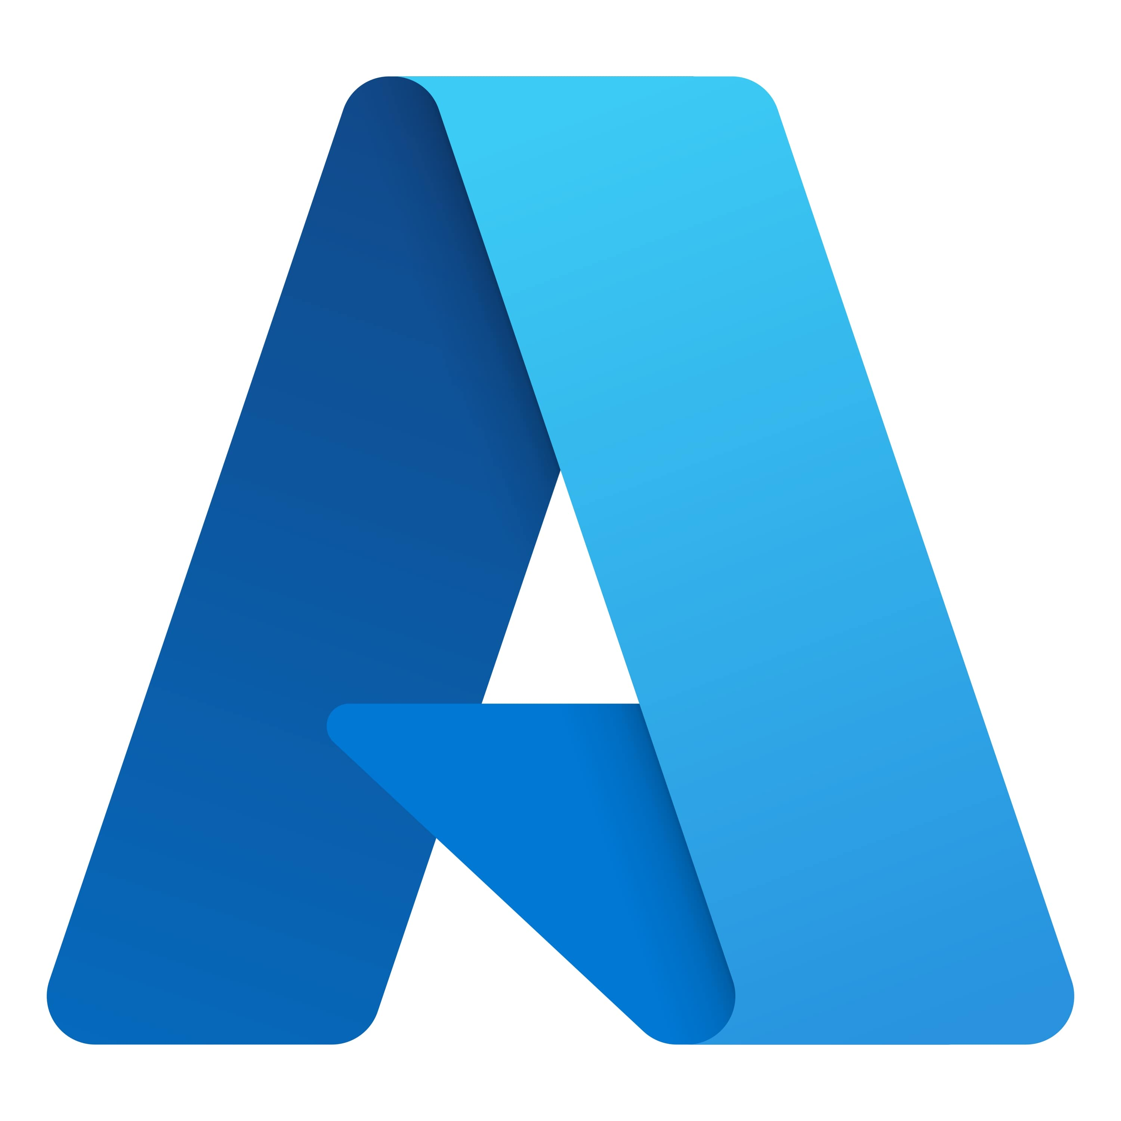
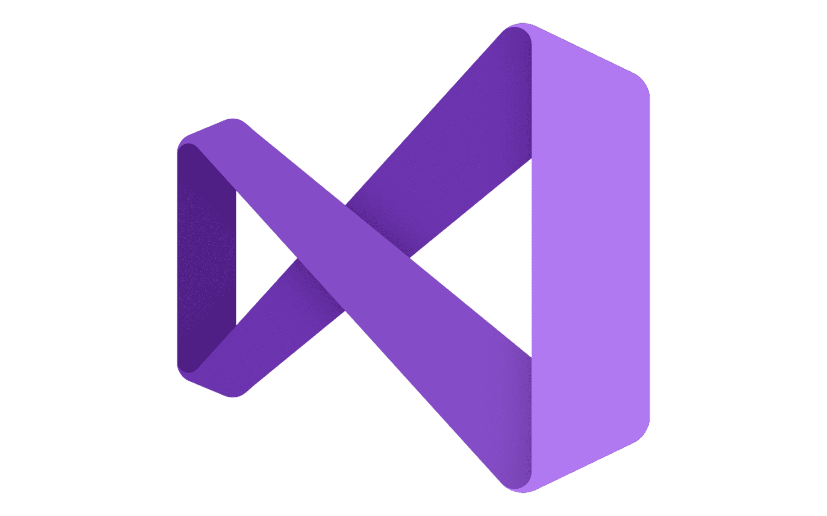







Azure AI Foundry
Copilot
Studio
Foundry Models
Cloud
Visual
Studio
Azure
Foundry Agent Service
Azure Arc
GitHub
Azure AI
Search
Azure AI
Services
Azure
Machine Learning
Azure AI
Content Safety
Foundry Local
Foundry
SDK
Foundry Observability
Edge
Security & Governance
Control
Azure Kubernetes Service
Azure App Service
Azure Container Apps
Azure Functions
Serverless

Slide 4

Azure AI Foundry: the agent factory
Models
1
Science
2
Trust
5
Azure AI Foundry
Observability
Knowledge and tools
4
3
4
Orchestration

Slide 5
Evolving RAG
What got us here won’t get us there

Slide 6


Knowledge for agents
Enterprise foundation
access control
Query
pipeline
agentic retrieval
Data pipeline
multimodal, multi-source

Slide 7
Purpose-built retrieval for RAG & agents

Slide 8
Query pipeline
Search → Agentic retrieval

Slide 9
Tackle harder questions from humans and agents
RAG first built on existing search systems: “top-K similar results”
Works
Doesn’t work
security updates KB4048959
what does ​KB4048959 fix and what systems is the patch compatibel with?

Slide 10


Classic search workflow
User query
L1
L2
→ LLM
Keyword search segmentation +
inverted index
Results as-is
from L1
Single-shot retrieval
Vector search
embeddings +
vector index
Reranking
e.g. cross-encoder
Linear
ranked list
Hybrid
RRF(keyword, vector)
No
interpretation

Slide 11
Announcing Agentic Retrieval
Announcing
Agentic retrieval
Agentic methods applied to retrieval
Query planning
Fan-out query execution
Results merging
User query
Query
planning
Search query 1
L1
L2
Merged results
…
L1
L2
Conversation turns
Search query n
L1
L2
Single LLM call
Use conversation history for context • Correct spellings in context • Decompose queries as needed • Paraphrase queries

Slide 12
Query planning & decomposition
Use chat history for context
(the user said earlier it was a security fix)
Split queries for different information requirements, resolving co-references
what does ​KB4048959 fix and what systems is the patch compatible with?
Correcting spelling is much more effective if done in sentence context

Slide 13
Agentic Retrieval API 1/2
POST /agents/myka
Agentic retrieval API
name: "…",
targetIndexes: […]
models: [{
kind: "azureOpenAI",
modelName: "…",
…
}]
Knowledge agents as first-class constructs
Agents bring together
    Target index
    Policies: ranker threshold, search depth, etc.
    LLM to use during retrieval
Upleveled retrieval API
    No dealing with vector encodings
    No separate inputs for keywords, vectors, reranker
    No need to understand the structure of the target index

Slide 14
Agentic Retrieval API 2/2
Agentic retrieval API
POST /agents/myka/retrieve
messages: [
{ role: "user", text: "…" },
{ role: "assistant", text: "…" },
{ role: "user", text: "…" },
],
targetIndexParams: {
indexName: "…",
filterAddOn: "…",
includeReferenceData: …
}
response: "…",
activity: [
{ type: "ModelQueryPlanning", …
},
{ type: "AzureSearchQuery",
query: { search: "", filter: "" }
},
{ type: "AzureSearchQuery",
query: { search: "", filter: "" }
}
],
references: […]

Slide 15

How do we know if it’s actually better?
Query
Answer relevance
Is the answer relevant
to the query?
Context relevance
Is the retrieved context relevant to the query?
Response
Context
Groundedness
Is the response supported by the context?
Source: The RAG Triad | www.trulens.org/getting_started/core_concepts/rag_triad/

Slide 16
Agentic retrieval evals
+40%
+30%
RAG answer relevance
RAG answer
result rate
For complex queries requiring information from multiple documents
Full evals results and methodology description: aka.ms/aisearch-arevals

Slide 17
Agentic retrieval evals
Datasets x Query Modes
Answer Score
Content Score
 | Dataset | Search API | Agentic retrieval API | Delta | Search API | Agentic retrieval API | Delta
Classical | MIML | 87.12 | 87.89 | 0.76 | 77.22 | 77.95 | 0.74
 | Support | 66.85 | 67.44 | 0.58 | 53.17 | 53.72 | 0.55
 | Content | 77.58 | 77.77 | 0.19 | 68.95 | 68.89 | -0.06
 | DAYI | 74.68 | 73.26 | -1.42 | 68.22 | 66.67 | -1.55
 | FDA | 63.03 | 62.41 | -0.62 | 55.73 | 55.28 | -0.45
 | Arxiv | 68.97 | 69.66 | 0.68 | 58.97 | 57.40 | -1.58
 | AVG Classical | 73.04 | 73.07 | 0.03 | 63.71 | 63.32 | -0.39
Complex | MIML | 44.59 | 55.84 | 11.25 | 32.16 | 39.46 | 7.30
 | Support | 43.92 | 61.06 | 17.15 | 32.48 | 44.88 | 12.40
 | Content | 46.18 | 58.99 | 12.81 | 33.93 | 42.82 | 8.89
 | DAYI | 40.58 | 48.52 | 7.94 | 31.21 | 36.75 | 5.54
 | FDA | 38.25 | 71.25 | 33.00 | 30.84 | 58.33 | 27.50
 | Arxiv | 33.43 | 48.83 | 15.39 | 25.55 | 35.74 | 10.19
 | AVG Complex | 41.16 | 57.41 | 16.26 | 31.03 | 43.00 | 11.97
Conversational | MT-RAG | 77.31 | 78.74 | 1.43 | 69.35 | 71.49 | 2.14
Total | Average | 58.65 | 66.28 | 7.63 | 49.06 | 54.57 | 5.51

Slide 18
Agentic retrieval evals
Query Types
Category | Search API | Agentic retrieval API | Delta
hotpot-qa | 39.10 | 63.74 | 24.64
keywords | 44.40 | 45.10 | 0.70
keywords-misspelling | 33.92 | 39.32 | 5.40
misspelling | 36.43 | 53.05 | 16.62
morehop-qa | 39.47 | 46.33 | 6.86
multihop-rag-comparison | 45.52 | 65.41 | 19.89
multihop-rag-inferential | 54.16 | 73.08 | 18.92
multihop-rag-temporal | 35.12 | 59.96 | 24.84
multihop_triplet | 38.73 | 43.51 | 4.78
table_querygen-4.4-o3-mini.yaml | 58.69 | 64.92 | 6.23
table_querygen-4.5-o1.yaml | 68.54 | 68.07 | -0.48
table_querygen-4.6-o1.yaml | 55.19 | 50.57 | -4.62
twiki-multihop-qa | 44.31 | 60.72 | 16.41
twiki-multihop-qa-dg | 39.25 | 66.76 | 27.51
vqa | 73.40 | 72.89 | -0.51
vqa_page_figure | 35.12 | 40.32 | 5.20
As expected:
Complex queries get better
Simple queries don’t regress

Slide 19
Agentic retrieval evals
Groundedness
Query Type | Dataset | Search API | Agentic Retrieval API | Delta
Classical | MIML | 83.58 | 83.52 | -0.06
 | Support | 76.72 | 76.68 | -0.03
 | Content | 83.01 | 81.85 | -1.17
 | DAYI | 84.12 | 83.00 | -1.12
 | FDA | 85.26 | 85.69 | 0.43
 | Arxiv | 72.05 | 73.05 | 1.00
 | AVG Classical | 80.79 | 80.63 | -0.16
Complex | MIML | 72.82 | 73.49 | 0.67
 | Support | 76.38 | 76.21 | -0.18
 | Content | 72.75 | 74.10 | 1.35
 | DAYI | 74.21 | 73.85 | -0.35
 | FDA | 78.22 | 78.34 | 0.12
 | Arxiv | 70.92 | 71.00 | 0.07
 | AVG Complex | 74.22 | 74.50 | 0.28
Conversational | MT-RAG | 81.63 | 82.56 | 0.93
Total | AVG | 77.82 | 77.95 | 0.13
As expected:
Agentic retrieval does not negatively impact groundedness in results

Slide 20
Data pipeline
Ad-hoc chunking & embedding →
RAG-specific data acquisition

Slide 21
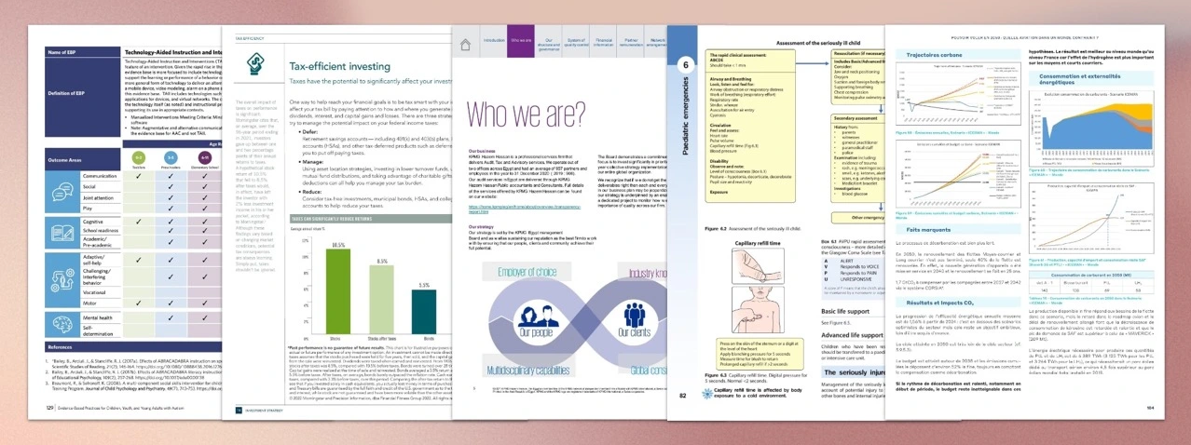
Real Business Content is Complicated
Far from just “chunk, vectorize, and index”
How do you handle content across media types?
What’s the most effective representation for retrieval?
How do you render grounding information in your app?
Source: Vision Document Retrieval (ViDoRe): Benchmarks, https://github.com/illuin-tech/vidore-benchmark

Slide 22
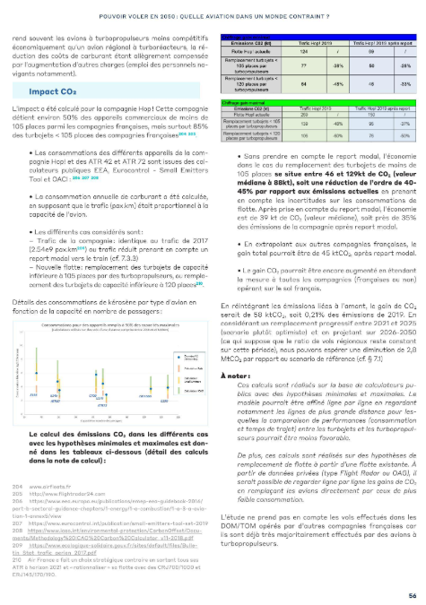
Powering Multimodal Scenarios
3
1
Verbalize images using a generative model
→ New GenAI Prompt Skill
2
Extract images so they can be used in app UI
→ Knowledge store
3
1
Extract and propagate layout information
→ Azure Document Intelligence
2
4
More options for chunking long text
→ Split skill improvements
4

Slide 23
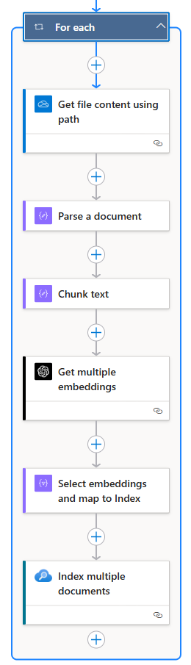
Flexible Data Ingestion:
Logic Apps + Azure AI Search
Broad variety of data sources
Starting with a few, will expand quickly!
OneDrive, OneDrive for Business, SharePoint, Dropbox, and more
Logic Apps rich set of capabilities
Workflows
Connectors, including authentication handling
Manageability
Set up directly from the Azure Portal

Slide 24
Security
Flat access →
Enterprise-grade granular access control

Slide 25


Why Granular Access Control?
Expectation
Challenges
If someone can’t see a given piece of data, they can’t see answers grounded in it
RAG over documents
requires indexes
Access control information
often not propagated
All queries need to enforce
access policies

Slide 26
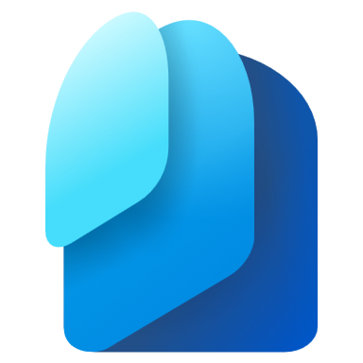


Native Entra-based access control
Announcing
Azure AI Search index
Microsoft Entra
id | Text, vector, metadata fields… | userIds | groupIds
… | … | … | …
… | … | … | …
… | … | … | …
… | … | … | …
id | Text, vector, metadata fields… | userIds | groupIds
… | … | … | …
… | … | … | …
Calling user/agent identity
Which groups can see this?
Which users can see this?

Slide 27
Propagate ACLs from data sources with indexers
1) Enable permission propagation in data source
{
"name": "mydatasource",
"type": "adlsgen2",
"indexerPermissionOptions": ["userIds", "groupIds"],
…
}
Two options for placing ACLs in Azure AI Search:
Push: bring your own ACL information
Pull: indexers propagate ACLs automatically
→ Starting with ADLS gen2, OneLake and others to follow
2) Map security fields to index fields in indexer
{
"name": "myindexer",
"dataSourceName": "mydatasource",
"targetIndexName": "myindex",
"fieldMappings": [
{ "sourceFieldName": "metadata_user_ids", "targetFieldName": "users" },
{ "sourceFieldName": "metadata_group_ids", "targetFieldName": "groups" }
],
…
}

Slide 28
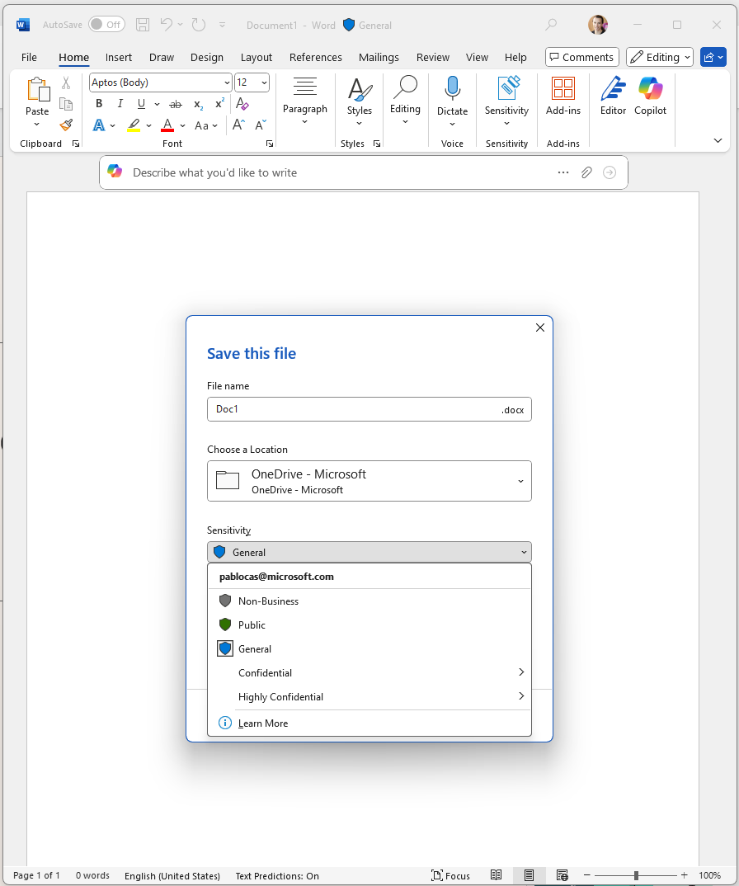
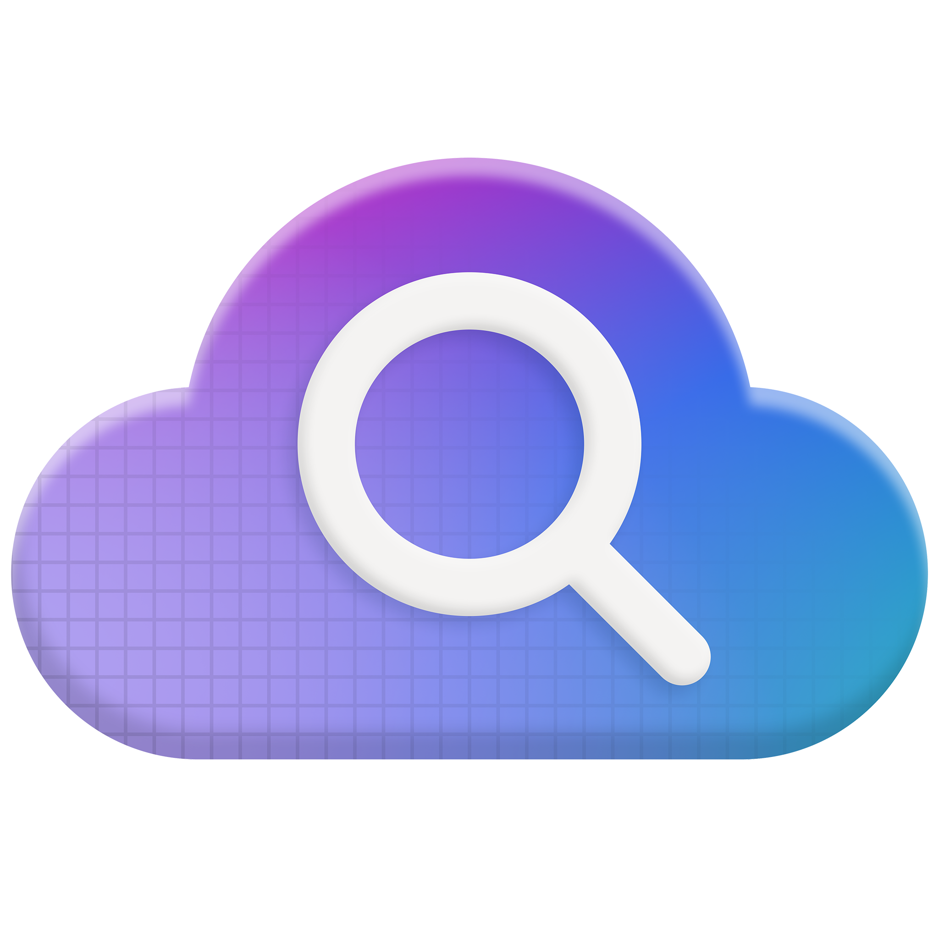
Sensitivity labels
Labels classify and protect enterprise data
Part of the Microsoft Purview governance capabilities
ACLs
File container:
e.g. blob storage, OneLake, ADLS
Labels are part of the document, independent of container
Azure AI Search now can:
Index encrypted content
Enforce label-associated policies
Label + policy
Join the private preview: aka.ms/AISearch-senslabels

Slide 29
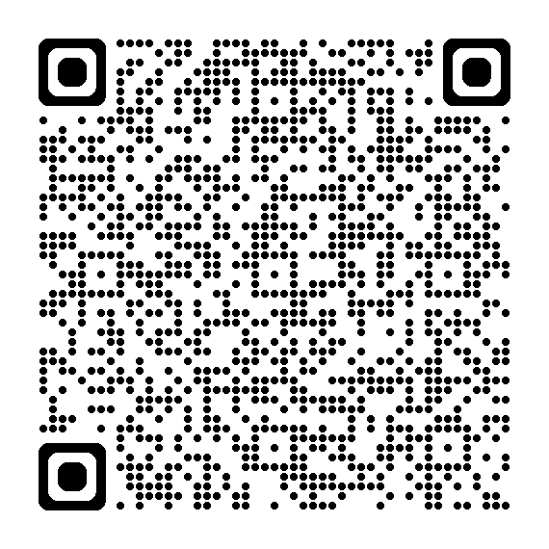
Want to test out sensitivity labels?
Join private preview
aka.ms/AISearch-senslabels

Slide 30
Doing it the modern way
MCP & Search for development

Slide 31


Azure MCP
Azure MCP Server
Resource groups
AI Search
CLI Extension
Monitor
Development oriented MCP server
for Azure
azmcp + vscode work great together!
Tuning APIs for AI agents that code
Self description, adapters
VS Code
Data Explorer
Cosmos DB
PostgreSQL
…

Slide 32
Call to Action
Resources
Learn
Try
Signup form | Private preview, sensitivity labels | aka.ms/AISearch-senslabels
Github repo | Agentic retrieval demo | aka.ms/ragchat
Github repo | Multimodal demo | aka.ms/aisearch-multimodal
Github repo | Azure MCP repo | aka.ms/azure-mcp
Github repo | Foundry MCP server | aka.ms/foundry-mcp
Blog | Agentic retrieval announcement | aka.ms/agentrag
Blog | Agentic retrieval eval results | aka.ms/aisearch-arevals
Blog | Multimodal updates | aka.ms/Build25/aisearch-multim
Docs | What’s new in Azure AI Search | aka.ms/AISearch-new

Slide 33


  Thank you
Session Code | Title | Times in PT
BRK155 | Azure AI Foundry: Agent factory | May 19 | 11:15am
DEM529 | Memory and agentic retrieval with AI Search | May 19 | 2:25pm
BRK153 | Knowledge retrieval: RAG for agents | May 19 | 6:00pm
COMM401 | Conversations: AMA with Pablo | May 20 | 5:45pm
BRK142 | Agentic RAG: build a reasoning retrieval engine | May 21, 12:30pm
LAB335 | Build your first agentic RAG solution with Azure AI Search | May 21, 4:30pm
Let’s keep the conversation going – stop by the Expert Meet-Up to get your questions answered.

Slide 34

Dive into the recommended next steps on the session page to take action with tutorials, resources, and code
Scan the QR code to access the session details page and fill out a session survey

